Slide 1



Starting Howitt Nursery
Powerpoint for Parents/Carers

Slide 2

What Is the EYFS?
The Early Years Foundation Stage covers the first stage of a child’s care
from birth to five years old. It sets the standards to ensure that all children
learn and develop, as well as keeping them healthy and safe.
All schools and Ofsted registered early years providers in England must
follow the EYFS.
Also included in the EYFS are the seven Areas of Learning. They are:
  Communication and Language
  Personal, Social and Emotional Development
  Physical Development
  Literacy
  Mathematics
  Understanding the World
  Expressive Arts and Design
At the end of the EYFS, there are 17 Early Learning Goals that children are expected to achieve.

Slide 3
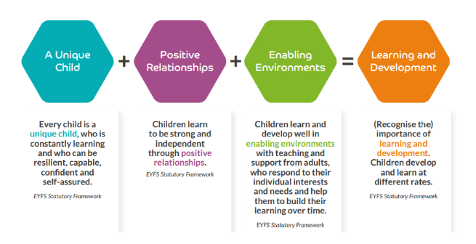
Principles of the EYFS
All children develop in different ways and development is not a linear or automatic process. It depends on each unique child having opportunities to interact in positive relationships and enabling environments that encourage their engagement and recognise their strengths. All children have potential and curiosity to learn, and will interact with other people and the world around them in different ways. Understanding these different ways of knowing about the world is central to understanding who children are and how best to support their development.

Slide 4
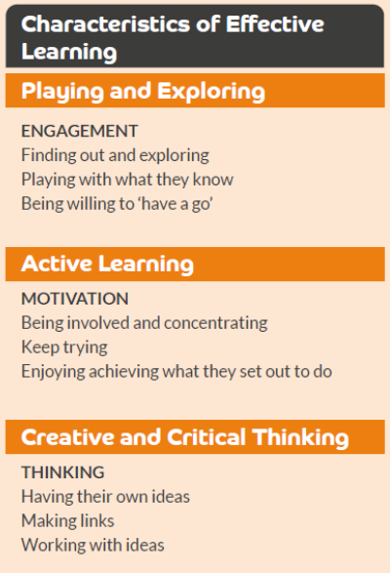

Characteristics of Effective Learning
The Characteristics of Effective Learning describe behaviours children use in order to learn.
To learn well, children must approach opportunities with curiosity, energy and enthusiasm. Effective learning must be meaningful to a child, so that they are able to use what they have learned and apply it in new situations. These abilities and attitudes of strong learners will support them to learn well and make good progress in all the Areas of Learning and Development.

Slide 5

The Prime Area of Learning
Prime areas of development and learning lay vital foundations in the early years. The three Prime areas, Personal, social and emotional development (PSED), Communication and language (CL), and Physical development (PD), describe universal core aspects of early child development. They are time-sensitive because of biological factors that enable rapid brain connections, particularly in the first three years of life but continuing throughout early childhood. Developmental steps missed at this early crucial stage are much harder to address later on, so it is crucial that children’s interactions and experiences in the first few years support development in these fundamental areas.
All three Prime areas are always in action for a young child. In every activity, the child is experiencing feelings and developing a sense of self and others, is physically engaged through their senses and movements, and is learning to understand and communicate with others. It is through these aspects that a child accesses the world around them and relationships with other people, which in turn opens the door to learning in all areas. The Prime areas therefore strongly influence learning in the Specific areas of learning and development.
While the Prime areas are especially crucial to early years provision during the first three years, they remain centrally important for children’s development and learning throughout the EYFS and beyond, and should receive priority attention to ensure strong foundations in development and learning.

Slide 6
Personal, Social and Emotional Development
Children settle, become confident learners and are able to manage their own basic personal needs
Children have healthy, happy and friendships
Children understand and manage their own behaviour and reactions
Children have an understanding of their own and others feelings, they know what makes them happy and what can contribute to them leading a healthy and happy life.
In nursery…
Feelings are ok and valid
Taking turns Vs Sharing
Having age appropriate/clear expectations
Routines
Transitions
Waiting – learning to be part of a group
Following appropriate rules – keeping themselves, others’ and resources safe
Sharing space
Being Healthy – making healthy choices
Oral hygiene
Going to the toilet
Self-regulation

Slide 7
Self-regulation
A pedagogy which includes co-regulation strategies will help children develop self-regulatory skills. Researchers have identified three basic strategies for co-regulation:
Positive Relationships – Provide a warm, responsive relationship where children feel respected, comforted and supported in times of stress, and confident that they are cared for at all times.
Enabling Environments – Create an environment that makes self-regulation manageable, structured in a predictable way that is physically and emotionally safe for children to explore and take risks without unnecessary stressors.
Learning and Development – Teach self-regulation skills through modelling, suggesting strategies, providing frequent opportunities to practice, and scaffolding to support children to use self-regulation skills.
Developing self-regulation, like many elements of development and learning, is not something children do by themselves. It is a process that grows out of attuned relationships where the caregiver and baby or child are closely attentive to each other and engage in sensitive, responsive exchanges.
Self-regulation involves children’s developing ability to regulate their emotions, thoughts and behaviour to enable them to act in positive ways toward a goal.
Self-regulation depends on and grows out of co-regulation, where adults and children work together toward a common purpose, including finding ways to resolve upsets from stress in any domain, and return to balance.
The foundations of emotional and cognitive self-regulation in the early years are integrally tied together, and both are necessary for behavioural self-regulation.

Slide 8

Communication and Language
Children are able to listen with good attention and understanding in small groups and when part of the class.
Children can speak clearly and be understood by others and have interesting and enjoyable conversations using good vocabulary, sentence structure and confidence.
In nursery…
Underpins everything within the EYFS
Listening – one to one
Listening – in a larger group
Communicate their needs
Enables the building of relationships
To form friendships
To cooperate
To make conversations – 2 way
To join in with songs, poems and rhymes

Slide 9

Physical Development
Children develop good spatial awareness, strength, balance and coordination when moving around and do so safely
Children develop the ability to make controlled movements using the small muscles in their hands and wrists giving them the strength to use tools with good control when drawing and writing correctly formed letters.
In nursery…
Gross Motor Skills
Core stability
Balance
Shoulder pivots/ muscle strength
Arm strength/
control
Range of movements
Spatial awareness/
sharing space
Fine Motor Skills
Hand and finger strength
Developing a pencil grip - progressive
Making marks - progressive
Making recognisable marks - progressive

Slide 10

Literacy
Children have favourite stories, get joy from stories, retell stories and make up their own
Children understand texts and can interpret what they see and hear or read
Children have a sound foundation of phonic knowledge that they can draw on to decode
and write simple sentences
Children believe in themselves as writers and write simple sentences
In nursery…
Reading
Love of reading – enjoying stories, poems and rhymes
Listening to stories, poems and rhymes
Joining in with stories, poems and rhymes
Understanding and sharing opinions about stories, poems and rhymes
Asking questions
Answering questions
Making links between stories, poems, rhymes, authors, illustrators, characters and settings.
Understand that there are non-fiction books
To use and reflect on books linked to a theme/topic
Writing
Gross and fine motor skills
Making marks in different ways – a sensory experience
Enjoying making marks – not always purposeful
Making marks in a purposeful way – being able to talk about them
To understand and talk about their marks with more detail.
Writing recognisable letter shapes
Writing recognisable letters – writing letters in their name
Writing recognisable letters – initial sounds

Slide 11

Phonics
Level 1 Phonics (Pre-Phonics)
Environmental sounds refer to the common noises we hear all around us in our daily lives. Learning to recognise a sound we hear is an important skill that's learnt in phase 1, as it allows children to understand what's going on in the world around them.
Environmental Sounds
Why is Phase 1 phonics important?
In Phase/Level 1, children do not learn any letters or the sounds they make. The purpose of Level 1 is to develop children's listening and communication skills, including their vocabulary, to prepare them for reading and writing in the next Phase/level.
Instrumental sounds are the noises created by musical instruments or other objects. In phonics lessons, these could be made with percussion instruments, like drums or tambourines.
Instrumental Sounds
The aim of this aspect is to develop children's awareness of sounds and rhythms. Activities include singing songs and action rhymes, listening to music and developing a sounds vocabulary.
Body Percussion
This aspect really encourages children to tune in to the sounds of words. Children need to build a stock of rhymes through hearing them lots of times in books or songs.
Rhythm and Rhyme
In Aspect 5 we encourage children to start listening for the phonemes in words. Ultimately, Aspect 5 aims to help children to hear the initial sounds of words.
Alliteration
Voice Sounds
The aim is to distinguish between different vocal sounds and to begin oral blending and segmenting.
Main purpose: To develop oral blending and segmenting of sounds in words. Preparation. Before starting oral blending think about times when you can use it for example when washing hands – 'turn on the 't-a-p, tap' also appropriate rhymes and songs you can use.
Oral Blending and Segmenting

Slide 12
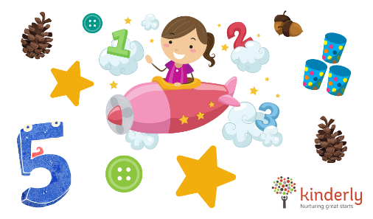
Mathematics
Children have good number sense which they can draw on when solving problems
Children understand number sequence; explore patterns in numbers, pairs of numbers,
even and odds, doubles and sharing,
Children have an understanding and talk about shapes, size, weight, capacity, position,
distance, time and money.
In Nursery…
Mastery of Numbers
…the ‘5ness’ of five
Joining in with number songs – forwards and backwards counting
Saying Numbers – Rote counting
Counting – How many?
Subitising – knowing how many without counting
Using number knowledge in real-life/practical games and activities
Problem solving using number knowledge
Recognising patterns
Continue repeating patterns
Talking about what shapes look like – what do you see?
Name basic 2D and 3D shapes
Use shapes in practical activities

Slide 13

Understanding the World
Children know about events and people from the past
Children gain an understanding of our local area, people and different communities around them
Children developing computational thinking by using technology within their play
Children develop a love and interest for the natural environment and know we need to respect and look after it. They explore and describe different materials around us and experiment how materials can change
In nursery…
Cultural Capital – Where do the children fit into their world?
Sense of self – Who they are?
Wider World –
Themes, topics and experiences
Sense of belonging –
Family
Where they live
The community
The wider world
Noticing the world around them –
Seasons
Animals
Weather
The more experiences they have the culturally aware they will be.

Slide 14
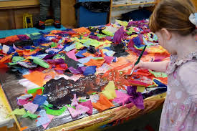


Expressive Arts and Design
Children create with a range of resources and materials and talk about what they have made.
Children develop their imagination and are able to express themselves with confidence in the form that is comfortable to them.
Children enjoy music-making, singing, dancing and responding to music.
In nursery…
Being Creative
Painting
Mixing
Printing
Using different tools and resources
Being independent
Process Vs Product
Crafting
Using crafting materials and resources
Art and design is subjective and individual
Being Imaginative
Drama/Role-play
Making links to stories
Singing
Making music
Talking about music

Slide 15

Intent
It is our intent that the children who enter our Early Years develop physically, verbally, cognitively and emotionally whilst embedding a positive attitude to school and learning. Within our setting we provide a stimulating environment that provides a fun, safe and creative area, rich in wonder and memorable experiences, which is suitable for each child’s unique needs and stages of development.
In EYFS we provide a climate of mutual respect, so children are able to solve problems, understand their own and other’s feelings and develop the social skills needed to learn, allowing them the confidence in their own ability.
Play is an integral part of learning and this is at the heart of our Early Years curriculum. We understand that children learn in different ways and we provide a mix of adult and child led activities, both indoors and outdoors. We recognise that children are happy, independent learners when secure relationships are formed and in place with both adults and their peers; these relationships enable our children to be curious and inquisitive about the world around them, allowing them to succeed in the ever changing world.
We work in partnership with parents and carers to provide and encourage our children to become confident and independent learners. We build strong foundations that encourage a love of learning: academically, morally and spiritually.
By the end of EYFS, our children develop resilience and independence and are emotionally prepared for the challenges in KS1, giving them a secure foundation as they move through school.

Slide 16

Curriculum
Play is an integral part of learning, and we believe it’s the most meaningful way for young children to learn. Therefore, play is at the very heart of our Early Years curriculum with children having extended periods of uninterrupted play each day. Our learning environments, both indoors and outdoors, promote independence and a love of learning. Children are able to access resources independently, make choices, follow their own interests and extend their own learning. This results in the children showing high levels of involvement and allows for deeper learning.
Each year our curriculum is co-created and guided by themes/topic as well as children’s interests and fascinations. In addition to this, we base our curriculum on the EYFS Statutory Framework and ‘Birth to 5 Matters’ guidance. Our curriculum is designed to provide children with the foundational knowledge and understanding, skills, and learning behaviours that will be built upon when they transition to Year 1.
We offer a balance of approaches in order to help our children learn:
Child-led play: children need time to learn through play without interruptions. It is through child-led play that children demonstrate what they’ve learnt and what they understand about a particular topic. Staff are skilled at extending the children’s learning ‘in the moment’ to ensure that learning is of the highest quality and that children make progress in their individual learning journeys. During the children’s play, staff assess what the children need to learn and how they can learn it in that moment, providing quality interactions that are specific to individual need.
Direct teaching: children take part in ‘carpet sessions’ that explicitly teach a skill/knowledge or to share stories, rhymes and poems e.g. phonics/maths.
Adult-led activities: staff target children that need a little support and modelling by engaging them in a playful activities that have a specific learning focus e.g. speaking in sentences through oral storytelling with props.
The adults may also guild the play by using specific resources and providing specific quality interactions.

Slide 17

The Continuous Provision – Common Play Behaviours
The purpose of an effective continuous provision is to offer children a constant environment that is safe for them to explore whilst challenging their learning. It should allow children the freedom to explore and become independent in making choices.
Children thrive within environments that support their individual and diverse development needs. Enabling Environments offer children security, comfort, choice, engagement and opportunity. Children’s learning is best supported when they have opportunities which allow for movement and action, creativity and imagination, independence and collaboration. Time outdoors benefits children by offering unique opportunities. Open-ended resources enable children to access and combine processes of development and learning. Inclusive spaces are nurturing and supportive of all children. Within an enabling environment, knowledgeable practitioners optimise the development and learning potential of every child.
Common Play Behaviours
This is a tool to ensure challenge for all learners using Continuous Provision and to add resources through the year. The resources facilitate the skills and are not defined to a particular level of skill but provides ideas of how to layer resources up into Continuous Provision as the children’s skills develop in each area.

Slide 18

Parent/carers partnership
Our early year’s team recognise parents’/carer’s commitment to their children’s early development and education and give priority to working as partners. The early year’s team are available for parents/carers at the beginning and end of every session, parents/carers have access to their own Google Classrooms page where they can keep up to date with their child’s learning and have communication with the class teacher. There are also opportunities to meet with the class teacher to discuss the children’s learning journey and next steps as well as regular invitations for ‘Stay and Play’ sessions focusing on a specific area of learning within the EYFS.

Slide 19
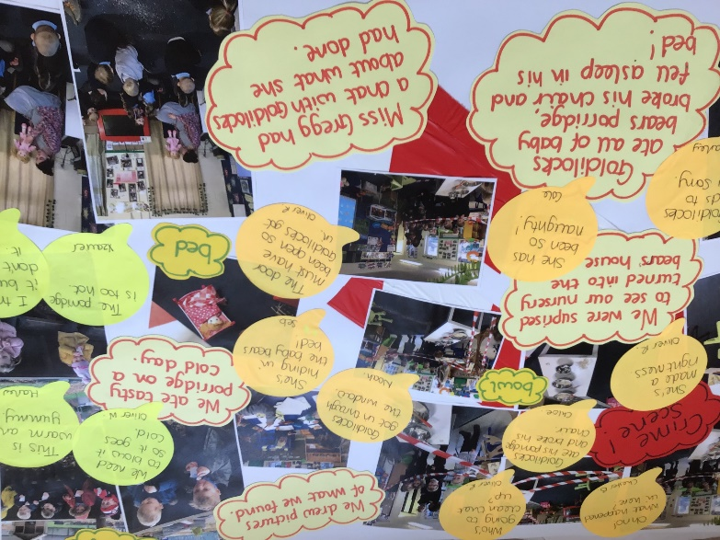
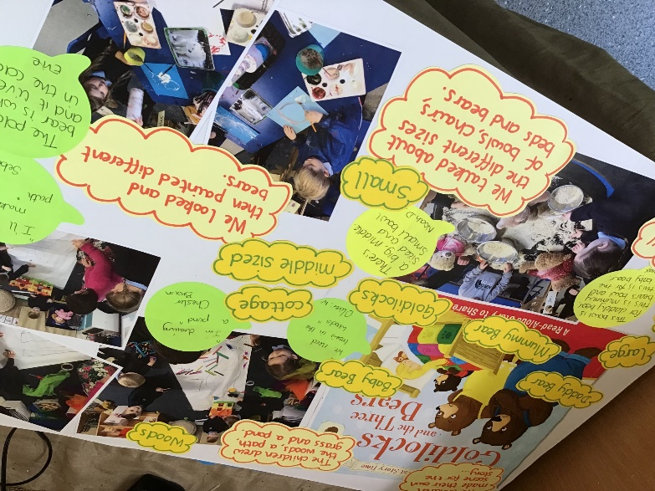
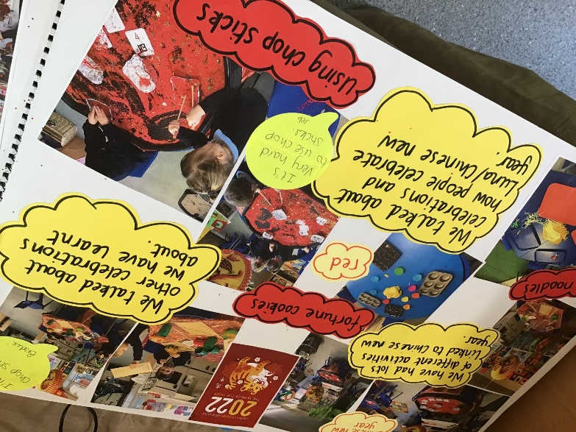
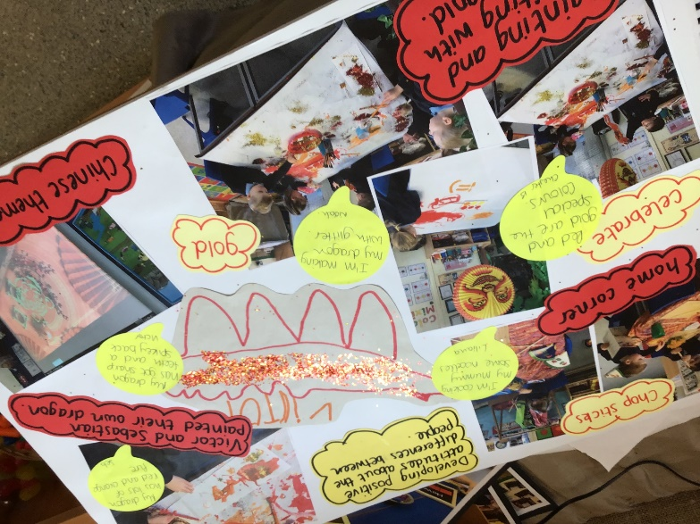
Floor Book
In the nursery we have a floor book where we evidence what learning has been taking place. This evidence can be photos of the children’s work, experiences, knowledge and skills. It also includes descriptions of the children’s topic/themed learning as well as the children’s own learning and interests, it also includes vocabulary and the voice of the children.

Slide 20

Attending Nursery at Howitt Primary Community School
Morning Nursery: 8.30am – 11.30am
Afternoon Nursery: 12.30pm – 3.30pm
All Day: 8:30am – 3:30pm
In England, from September 2025, eligible working parents can access 30 hours of government-funded childcare per week for children aged 9 months to under five years old. This builds on the existing entitlement of 15 hours for all 3 and 4-year-olds, and provides 15 hours for some 2-year-olds. The entitlement is available for 38 weeks of the year, though some providers may offer a "stretched" model. You must meet specific eligibility criteria for the 30-hour entitlement, and you need to apply online at GOV.UK.
For Children Aged 9 Months to 4 Years Old
30 Hours Funding: Starting September 2025, eligible working parents can get up to 30 hours of funded childcare.
Eligibility: You must meet certain criteria to be eligible for the 30-hour entitlement.
Application: Apply online via the GOV.UK website after checking your eligibility.
For Children Aged 3 and 4 Years Old
15 Hours Funding: All children in England are entitled to 15 hours of free early education.
For Children Aged 2 Years Old
15 Hours Funding: Some 2-year-olds are entitled to 15 hours of funded childcare, particularly if their families receive certain government support.
Where to Find More Information
Visit the GOV.UK website to find out more about eligibility and how to apply.
Check with your local council for details specific to your area.
For information on childcare in other parts of the UK, visit the relevant section of GOV.UK.

Slide 21

Snack Time
All the children in nursery have access to snack and drinks. We encourage the children to be independent with their snack time and can choose when they have snack and how much they have.
The snack time area is a place where they can refuel, socialise with friends and show their independence skills in managing their eating habits.
We provide healthy snacks including fruits, vegetables, crackers, bead sticks,
cheese etc.
To keep the variety of snack we offer the children we ask for a voluntary contribution of a £1 a week.
Thank you
Children can bring their own water bottle if they choose to, but we do provide drinks in the snack area.

Slide 22
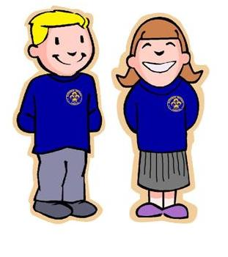
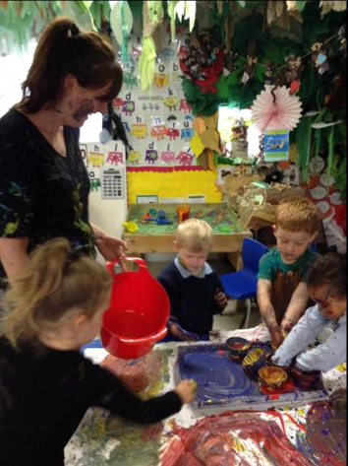
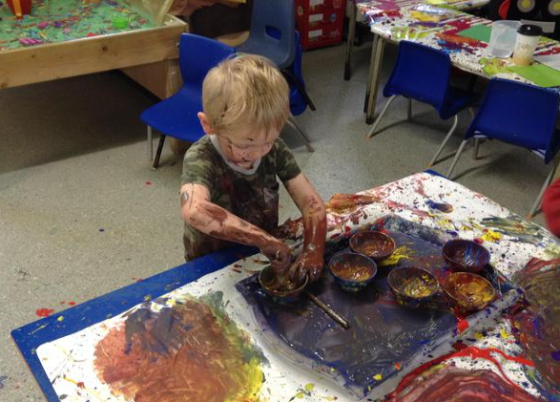
Nursery uniform is not compulsory but is recommended. It helps the children ‘fit in’ to the wider school community and saves your child’s own clothes from Nursery wear and tear!
The children may also get dirty as they are playing and exploring in nursery – you may want to provide wellies, puddle suit, older coat.
blue polo shirt
grey skirt or trousers
navy cardigan or school sweatshirt
Please remember to label all items
of clothing!

Slide 23


