Slide 1

Competition Time

Slide 2
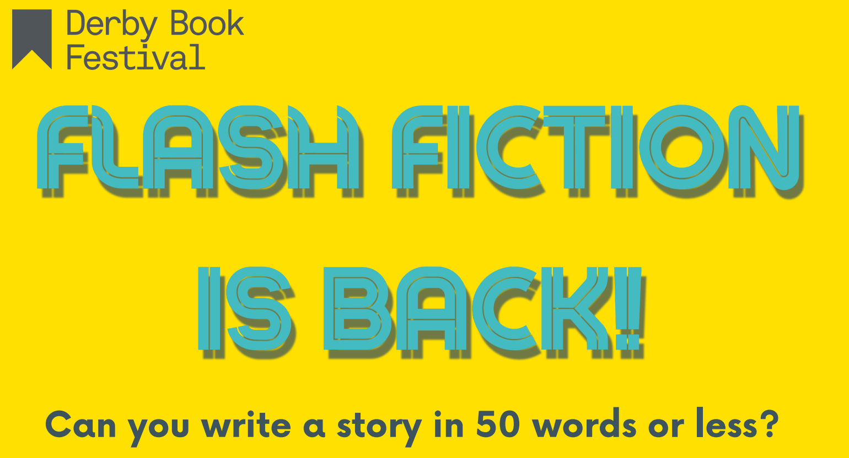

Slide 3
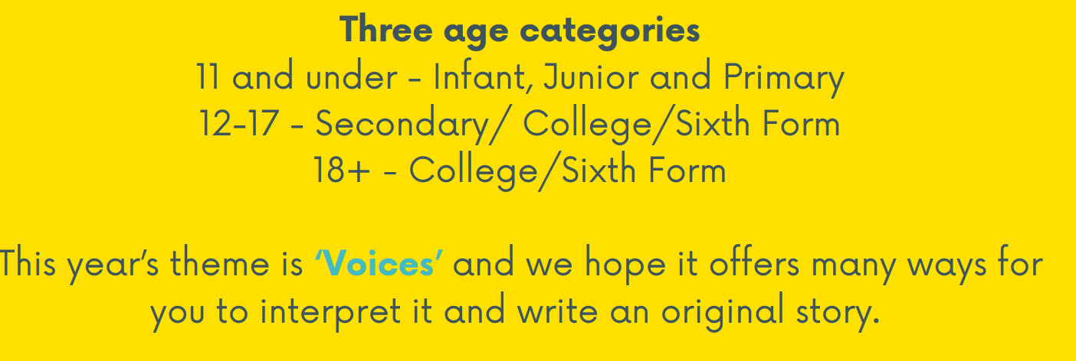


Slide 4
What is ‘Flash Fiction?’
Flash fiction is a brief fictional narrative that still offers character and plot development.

Slide 5
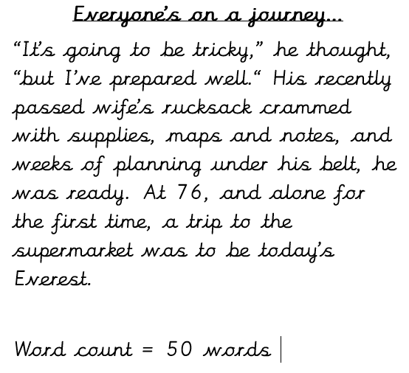
Previous year example
Theme: Journey

Slide 6
Spring Clean
“I hate ladders.” I groan, scrambling into the loft. Boxes, broken suitcases, vacuums, and twelve biscuit tins stuffed with tat. “Why’d he keep them?” I open the nearest, reading its label. Nursery to Primary. It’s filled with pictures, rubbish really. But I well up. Because they’re mine, every last one.

Slide 7
Water for Sale
Pick up bottle. Read label. “Spring Water” it says. “Natural free-flowing source.” It used to flow freely, roaring and rising and replenishing. Not anymore. Now it sits in my hand. Dormant and caged in plastic. Ready to be bought and sold, not free anymore. Still. Shake bottle. Put it back.

Slide 8
I am a coiled spring
"I'm like a coiled spring, a lion ready to pounce,
My dissatisfaction grows daily, ounce by ounce,
I try to contradict, to change my mood
I try meditation, anything to improve
Still, the coil winds up, until my belly aches,
Fearing what will happen when the spring
finally breaks"

Slide 9
Voices
For example, you could focus on:
your voice and how you use it
the difference a group of voices can make
a voice that has brought you joy - from a singer, actor, or a friend or family member
different ways we use our voices, from talking to singing, rapping, rhyming, whispering, and more
losing your voice (literally or figuratively)
how you use your voice to inspire other people

Slide 10
The title is not included.

