Slide 1
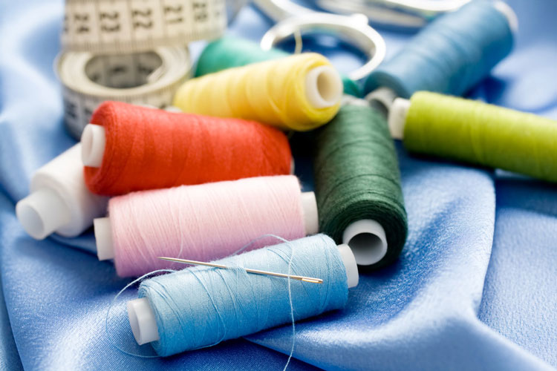
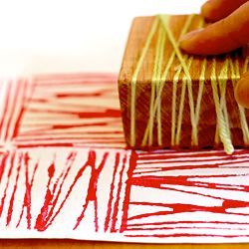
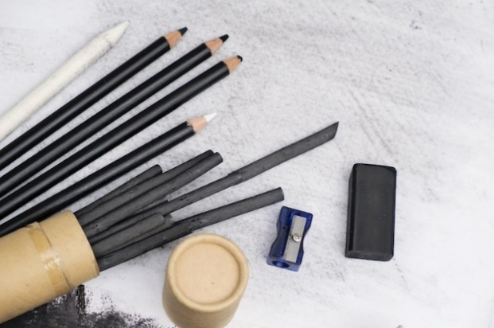
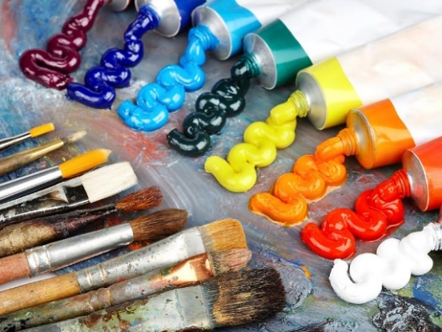
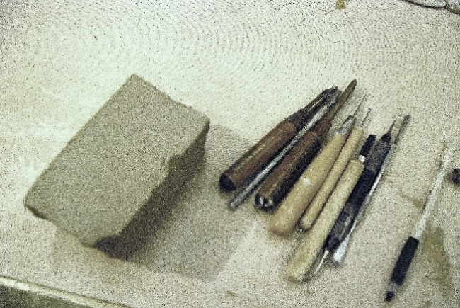
Art & Design
Year 5 and 6

Slide 2
Brief:
To produce a ‘Remembrance Day’
T-Shirt to wear on remembrance day.
Skills:
To draw and paint, photograph and manipulate images using the computer programme ‘Inkscape’, and finally print a design onto a white T-shirt using transfer paper.

Slide 3
Week 1
To develop an historical understanding of the poppy as a symbol and carry out design research.

Slide 4
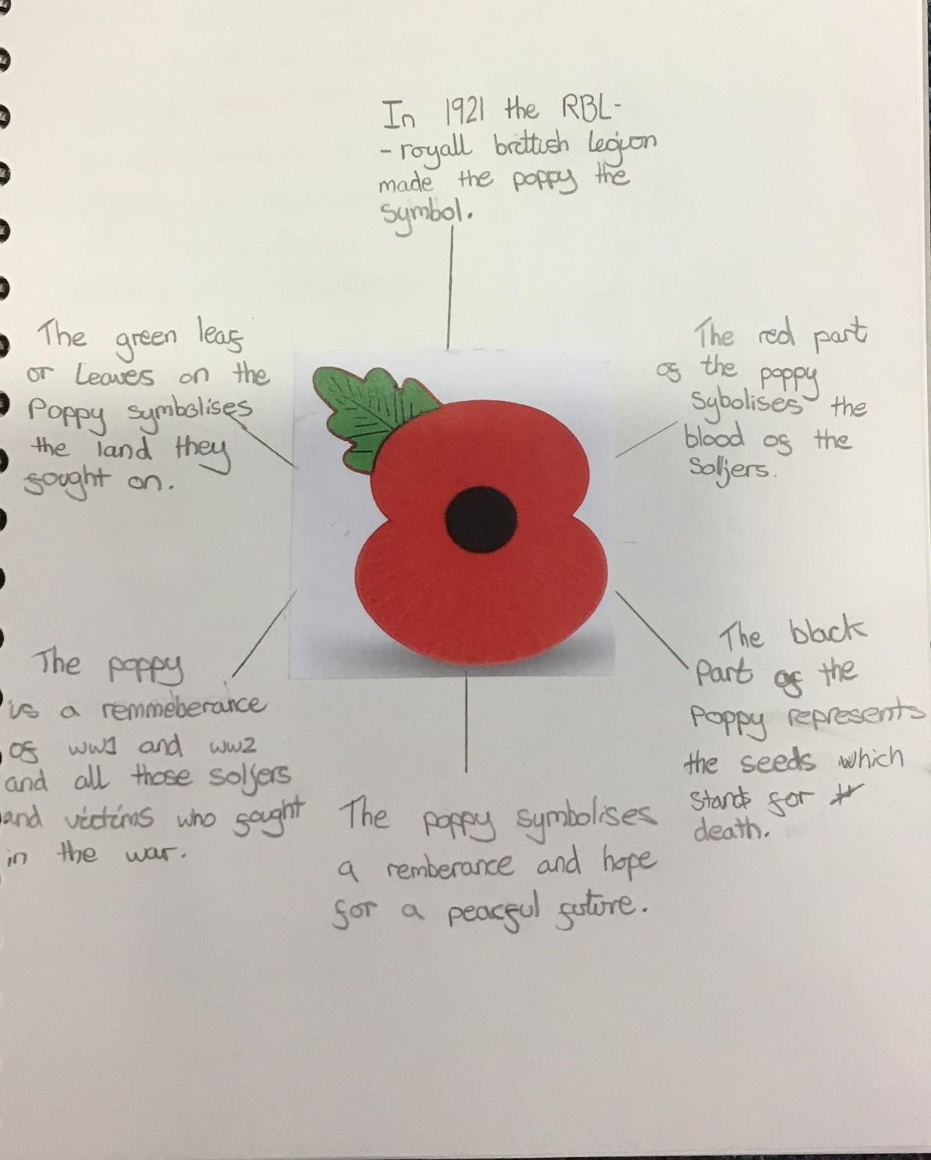
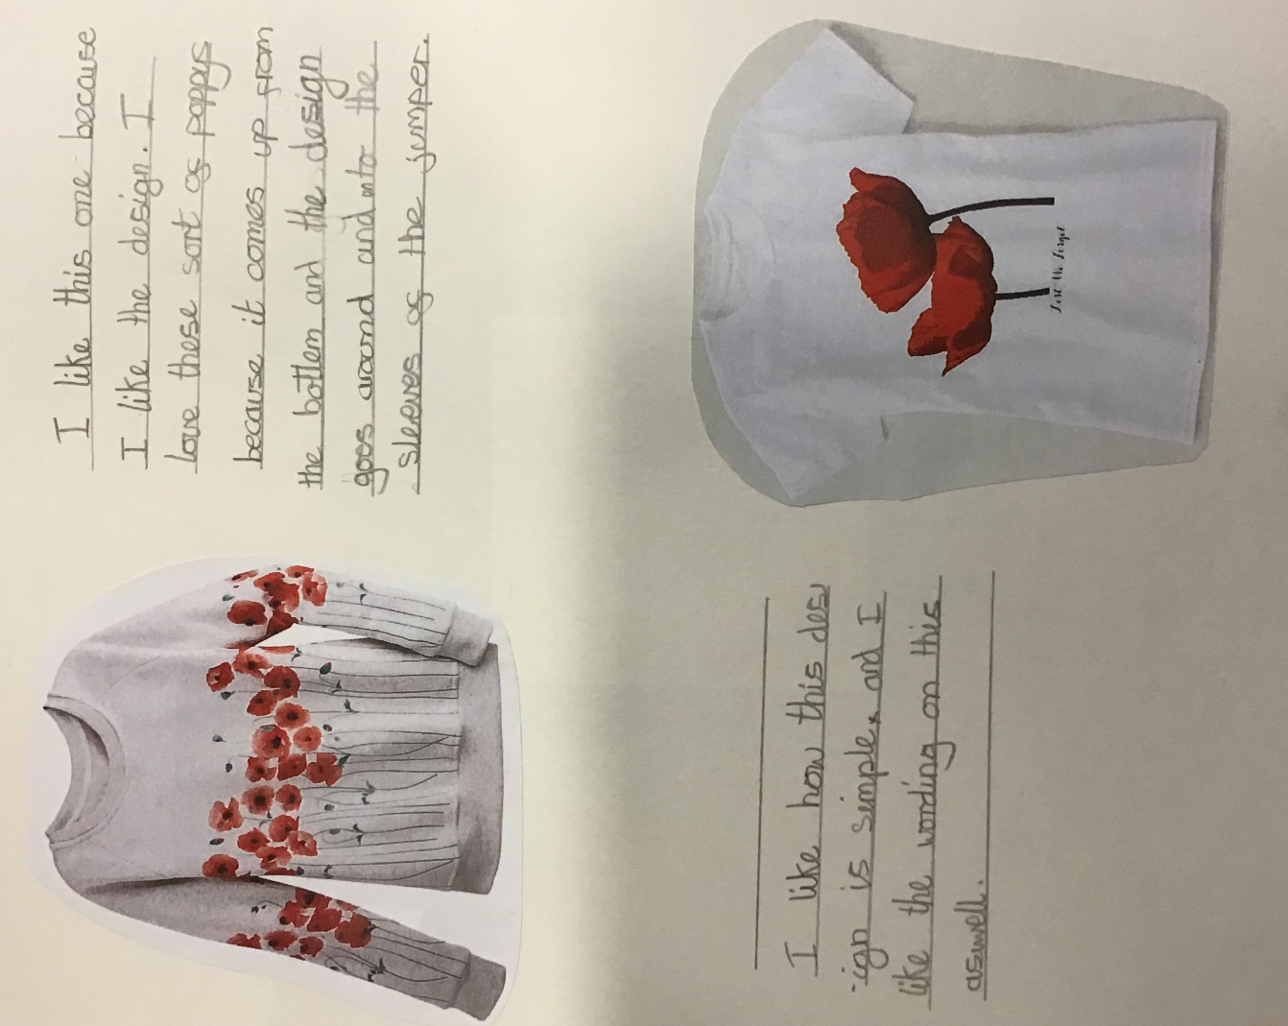

Slide 5
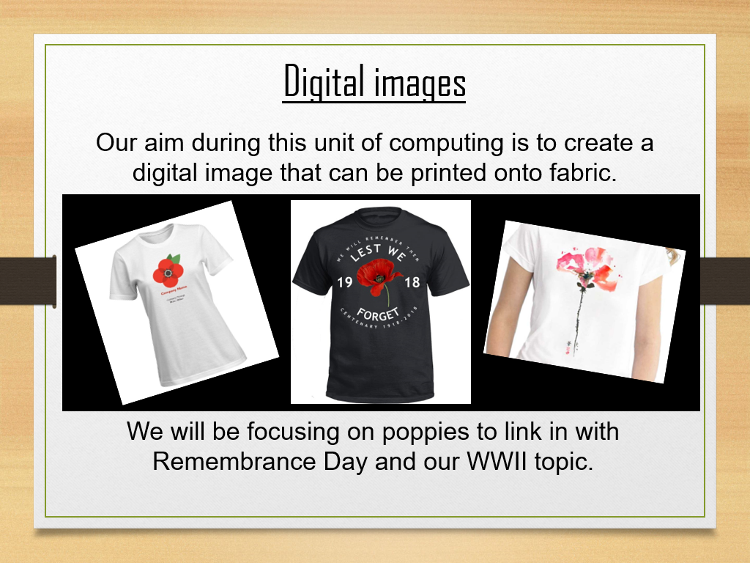
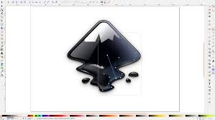
Computing.
Inkscape software program.

Slide 6

Digital images ​
​
A digital image is a picture that is stored on a computer. It has been digitised, which means it has been changed into a sequence of numbers or lines and curves that computers can understand.​

Slide 7
Week 2
To use observational skills to produce initial drawings of poppies.

Slide 8
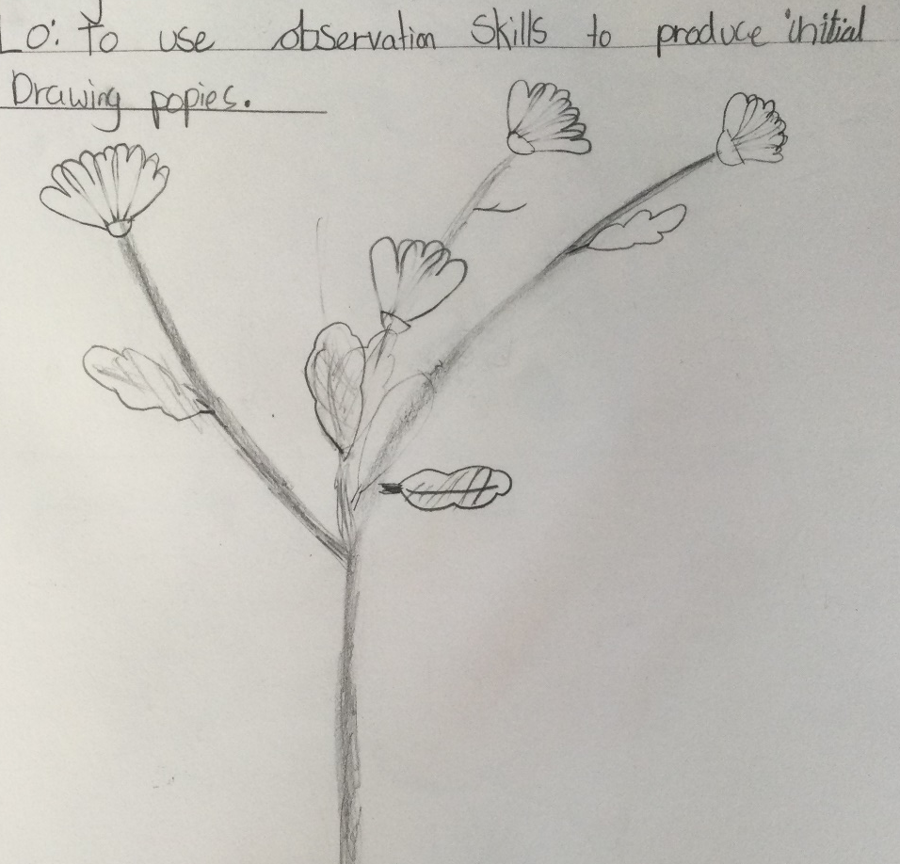
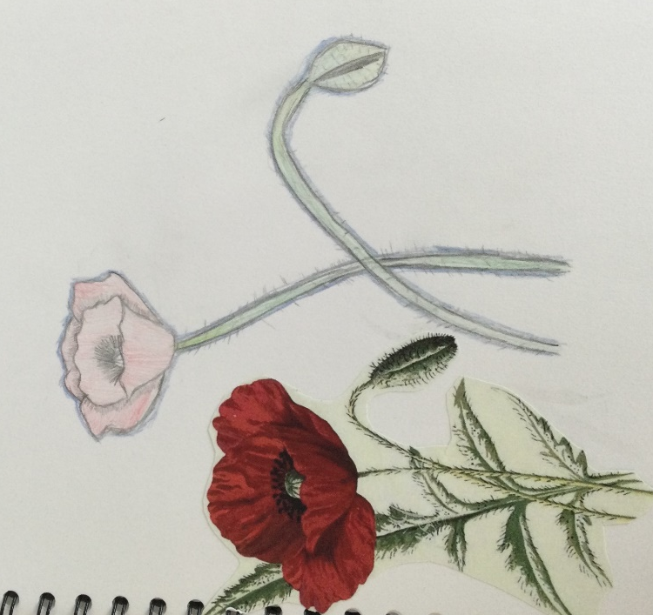
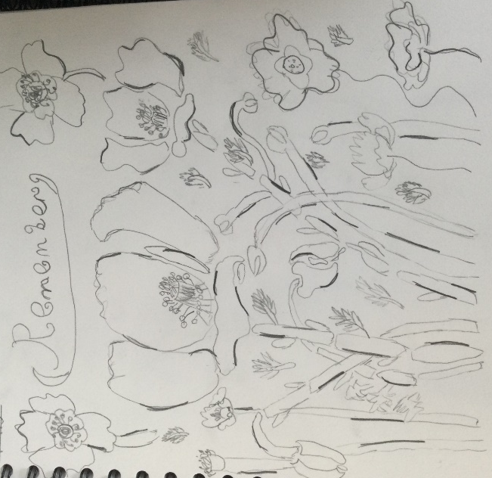

Slide 9
Week 3
To create vibrant tones by painting colours in layers.

Slide 10

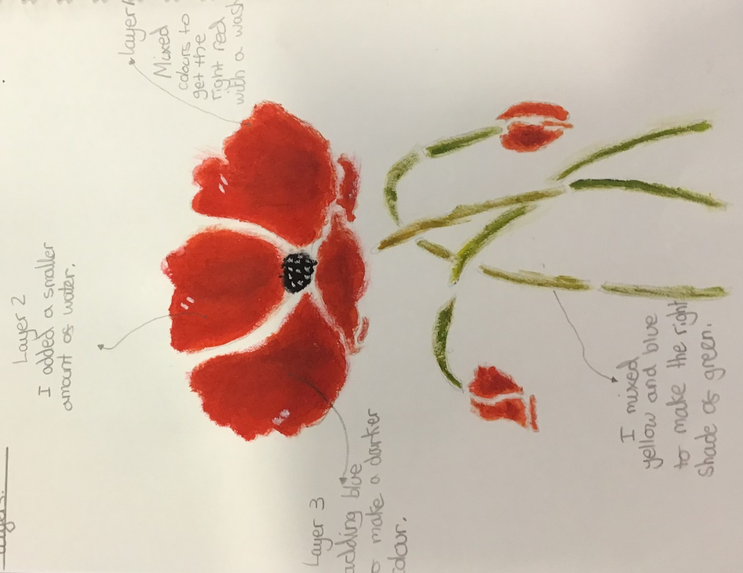

Slide 11
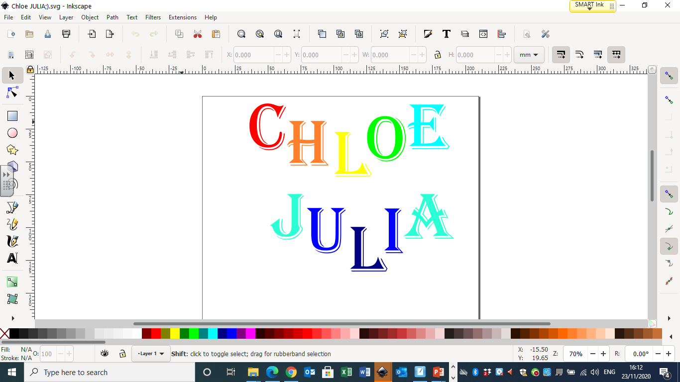
We manipulated text using Inkscape.

Slide 12
Week 4
To plan and design a poppy T-shirt.

Slide 13
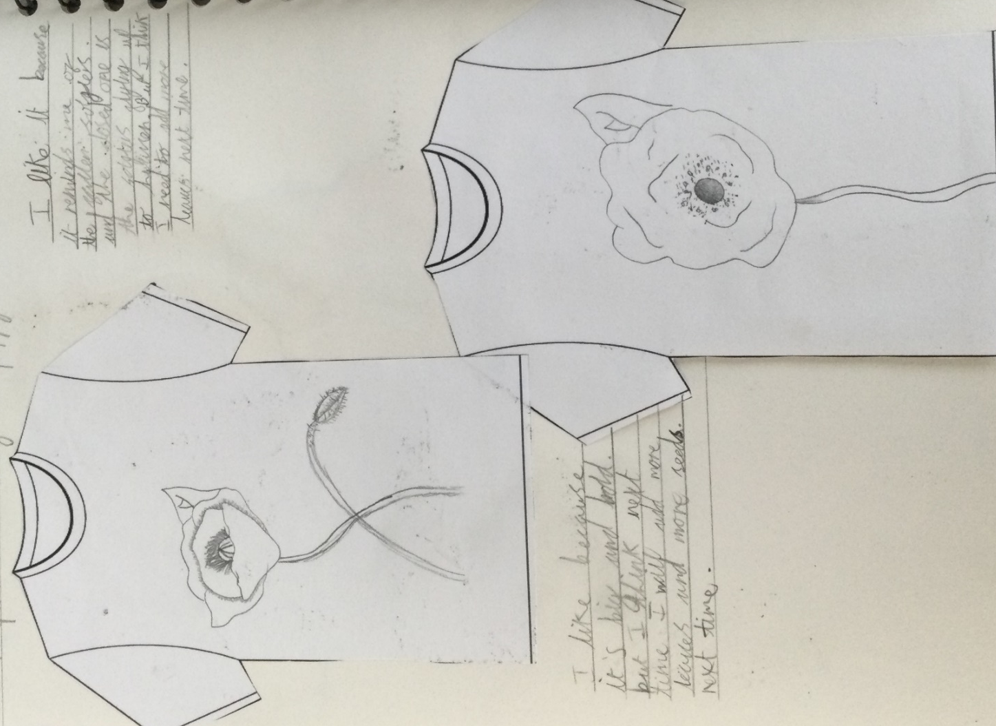
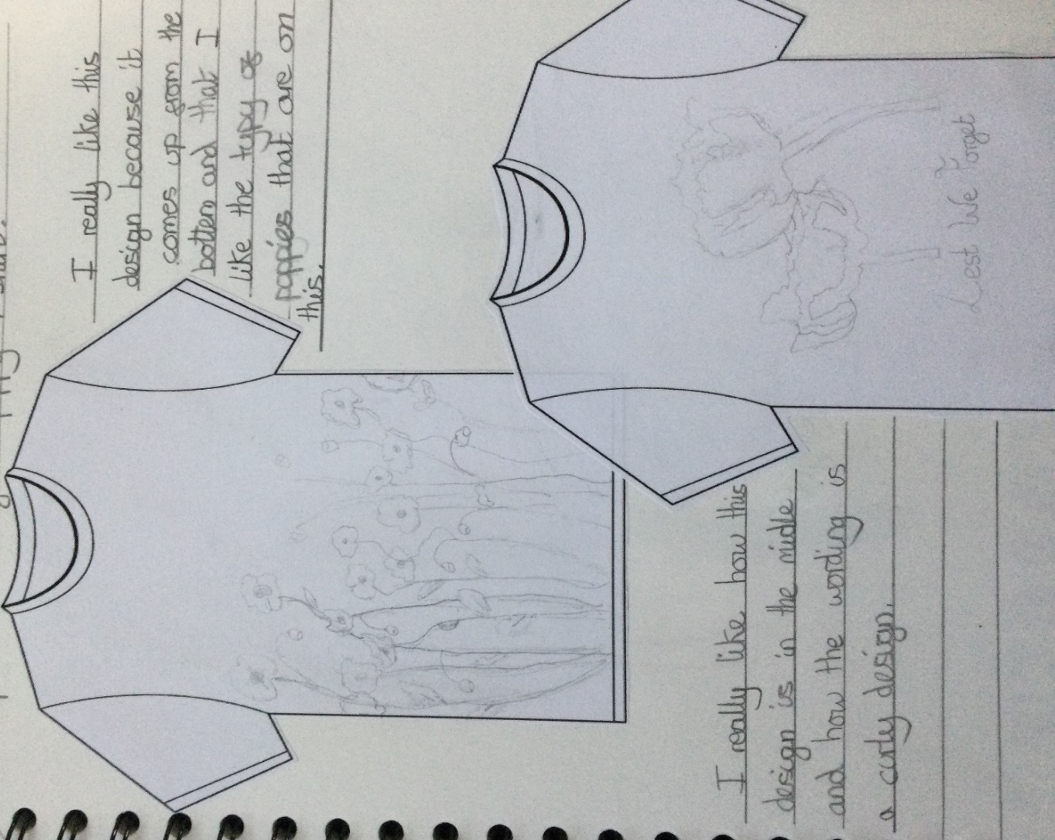

Slide 14
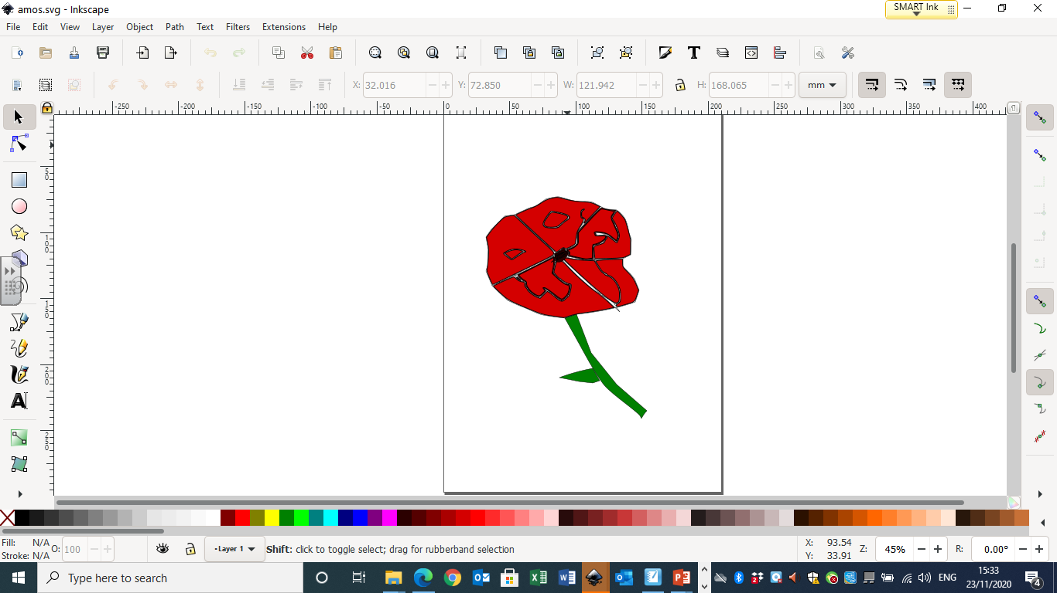
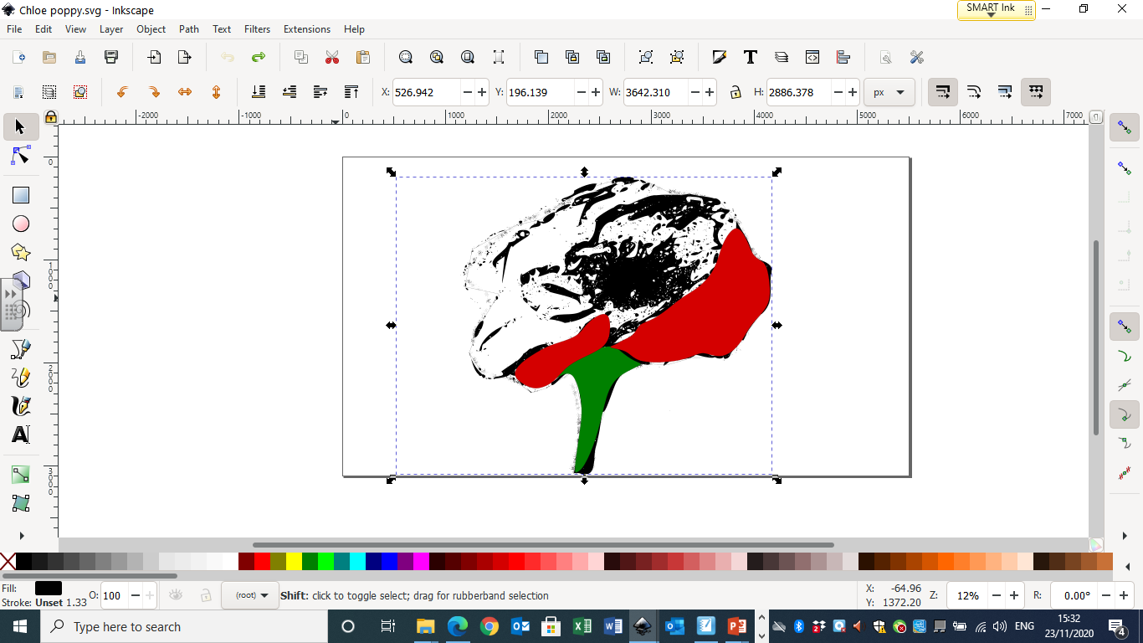
We learned how to use the trace bitmap tool and started to trace individual parts and colour them.

Slide 15
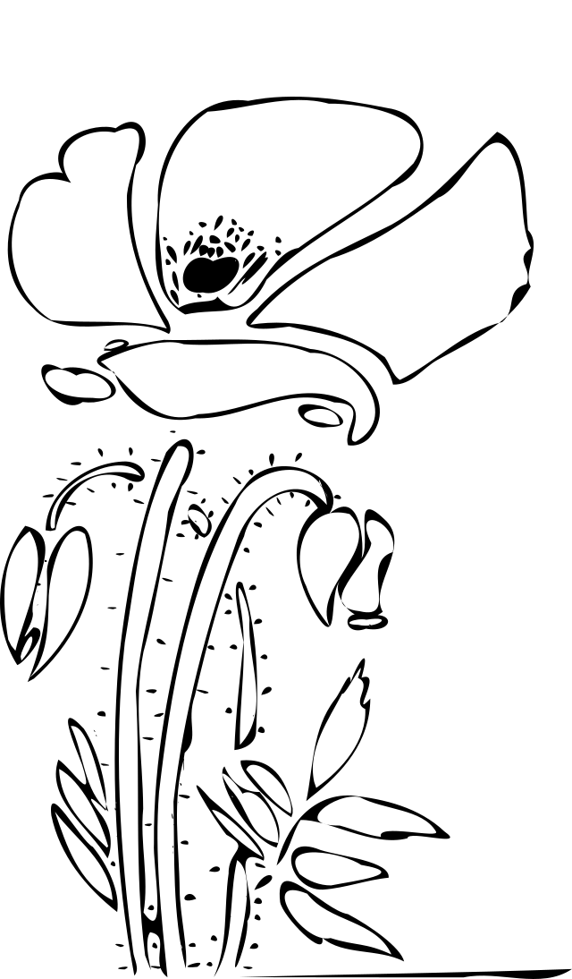


Slide 16
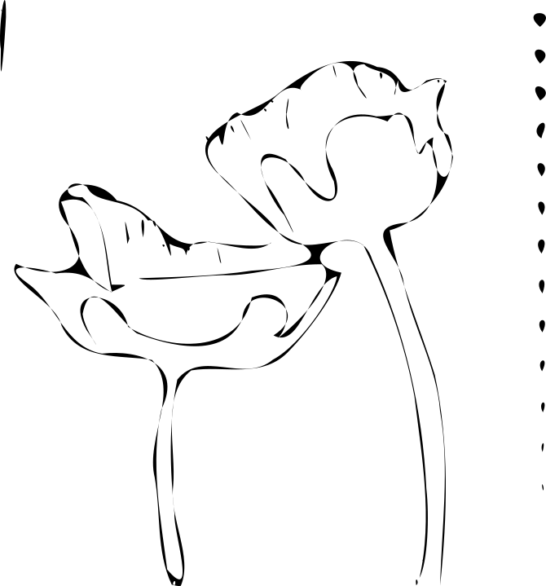
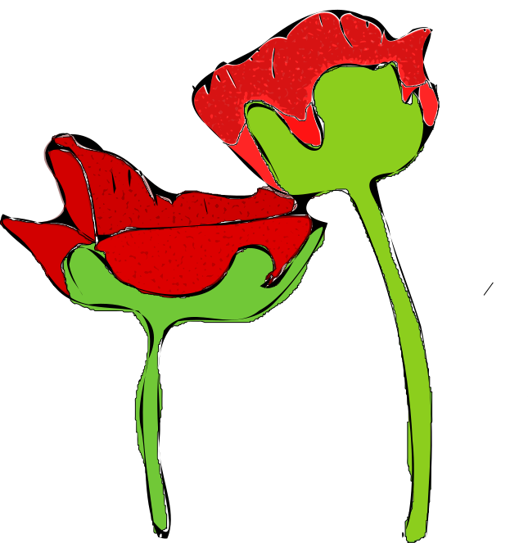

Slide 17
Week 5
To produce a final computer design.

Slide 18
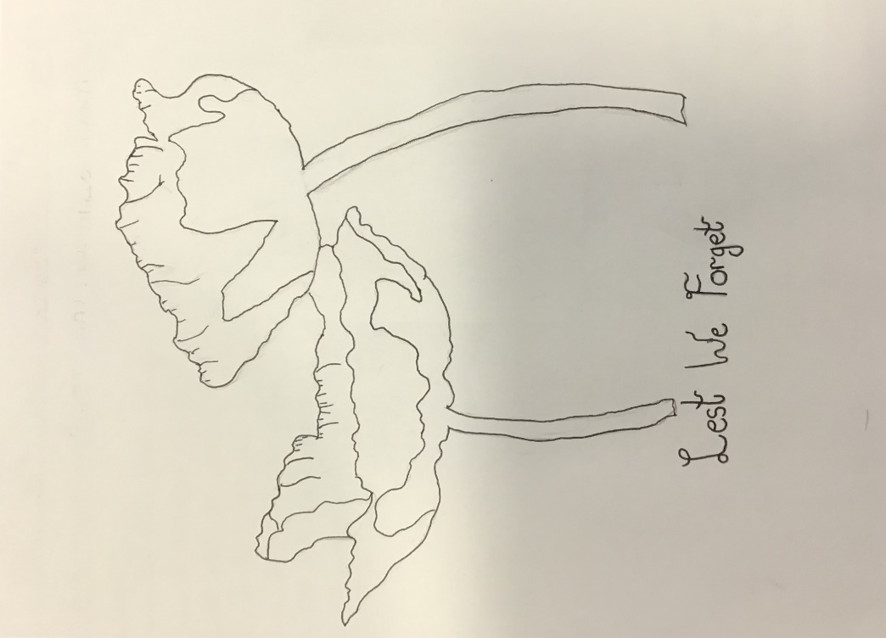
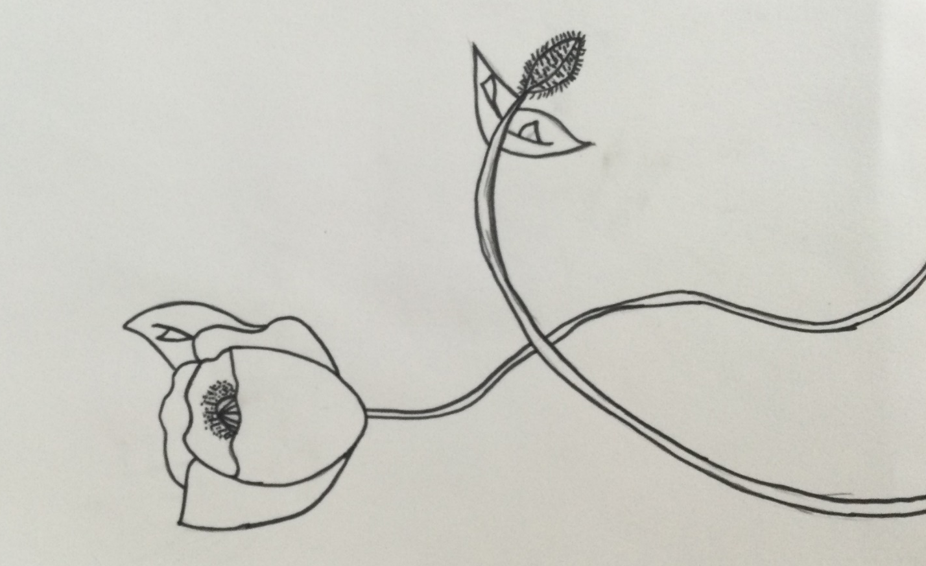

Slide 19
Week 6
Now the exciting part.
We used all of our learned knowledge to produce our final bitmap, trace and colour our design.

Slide 20
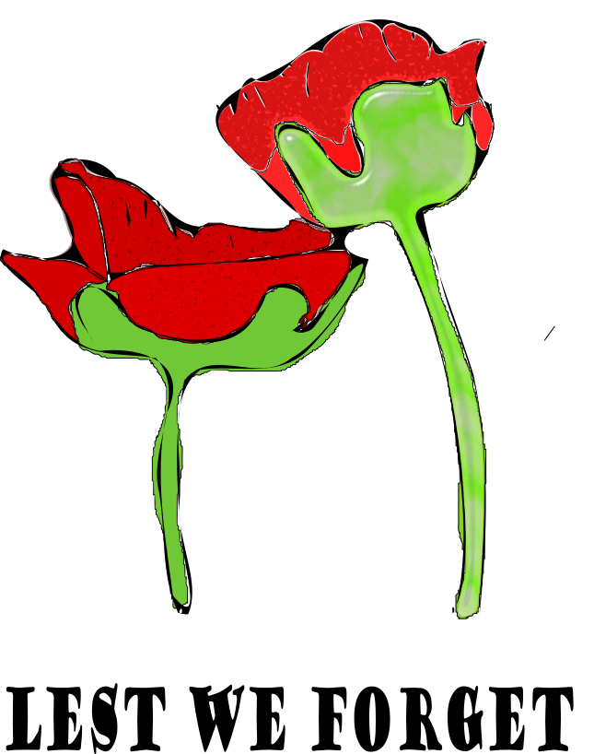
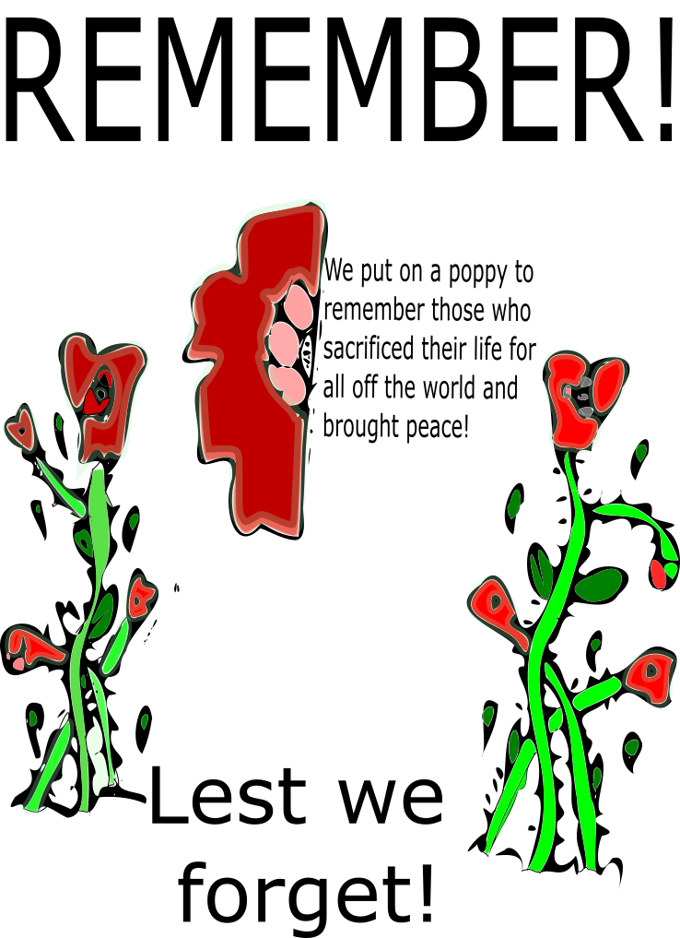

Slide 21


